Slide 1


Solution By: Zombies
PSID: INTL-DA-07
Team Leader Name: Girijessh M

Slide 2

Idea Introduction
IDEA TITLE- SAVEZE
Tech Stack
1.Java
2.Firebase
3.Android studio
Resources Used
1. Field research
Any Third Party API/Services used
Yes
IDENTIFICATION OF CRIME PRONE AREAS
Analyzing and identifying patterns in different type of crimes and alert them. Users can check for secure places and contact roaming police in their proximity. Platform for users to exhort their concerns .

Slide 3
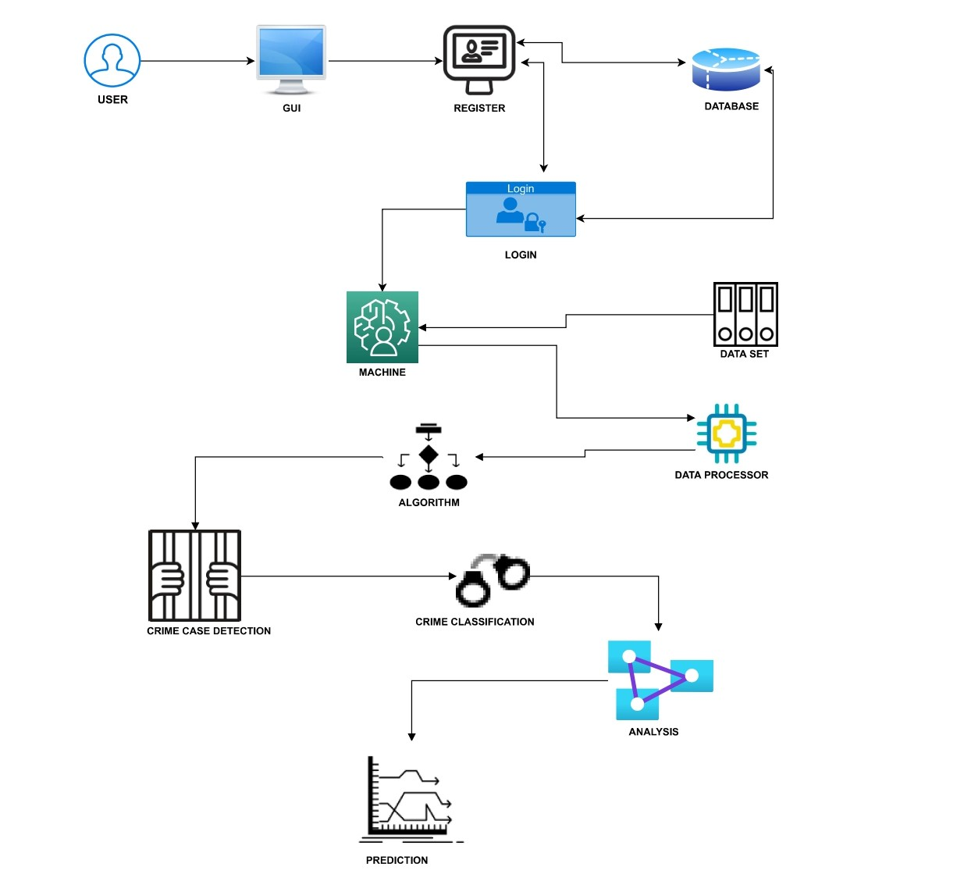
Your Approach Towards Idea
We have used agile scrum methodology to develop this project.
The increase in crime rate lead us to the idea of recognising crime prone area and alerting the users.
Identifying safe places and on duty polices near by the users. Verified volunteers can give updates on current issues. Portal for users to entreat their problems to concerned officials.
We might need data and cooperation from the government for further development.
Notes:
Use any image of your proposed solution here instead of this macbook image

Slide 4
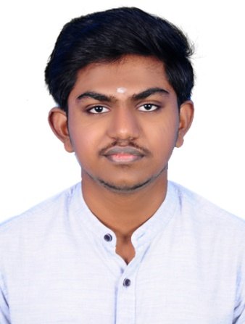
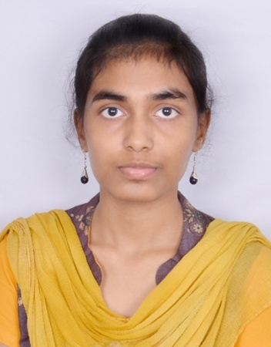
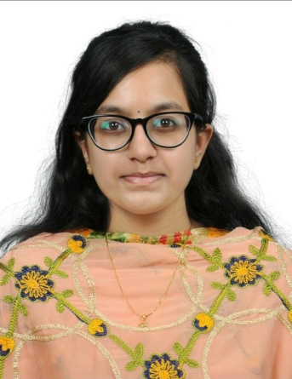
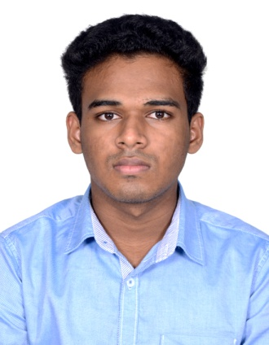

Team Slide
Girijessh M
Sanchana M
Rakashita T
Gopi Krishna S
Raino Shalon R

Slide 5
Development Pipeline
Documents To be prepared for installation and evaluation
1.Flowchart
2.Prototype
Any Third party API used, if yes please specify
Firebase
Proposed Development Plan in pointers
1. Analyzation of problem statement
2. Field research
3. Identification of crime pattern
4.Wireframing and prototyping
5.Developing the application
6.Evaluating and testing
Repository Link or any references link of folders
https://github.com/the-zombies/saveze
Proposed UI and functional flow in pointers
1.Login/Sign up
2.Home page
3.Petition
4.Crimes in a location
5.User profile and settings
Step A
Step B
Step C
Step D
Step E

Slide 6
Vision of Innovation/Idea/Solution
In order to prevent the increase in crime rate we came up with new resolutions and scopes. We wanted people to be aware of crimes around them and take precautions accordingly.
In comparison with other app we came up with new features like identification of crime patterns, pre-warning system and identifying secure places.
It will take about 2-3 months to implement our project.
First we thought of a simple app where we can get to know the crime prone area. Later we added extra features like safe places and many more.

